Slide 1

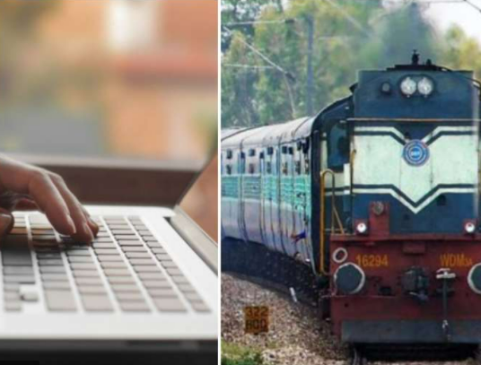
Train Case study
BY:
Abhinav T
Neha Sapalya
Neha Mittal
Divya Prakash
Samreen Fathima L

Slide 2
Description
The railway reservation system facilitates the passengers to enquiry about the trains available on the basis of source and destination, booking and cancellation of tickets, enquiry about the status of the booked ticket, etc.
The aim of case study is to design and develop a data base maintaining records of different trains, train status and passengers.
This project contains introduction to the railways reservation system. It is the computerized system of reserving the seats of train seats in advance.
Online reservation has made the process for the reservation of seats very much easier than ever before.
There are 2 logins : (1)User (2) admin

Slide 3
Problem statement
This Case Study involves generating a train ticket and printing the ticket to a File. The application should take train number and passenger details as input.
The details of the train should be stored in a database. The train details to be stored in database are Train number, Train Name, Source Station, Destination Station and Ticket Price.
The train details should be fetched from the database using the train number provided by the user. The passenger name, age and gender should be accepted from the user.
The application should generate a train ticket using the train details and passenger details.
The generated ticket should contain the following details • PNR Number, Travel date, Train Number, Train Name, Source Station, Destination Station • Name, age, gender and ticket fare for each passenger • Total Ticket price
The generated ticket should be written to a File.

Slide 4


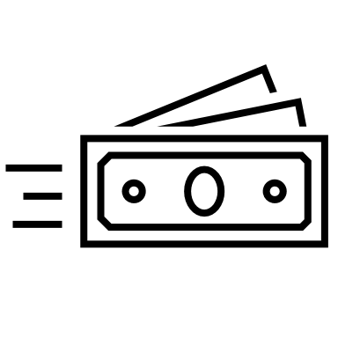




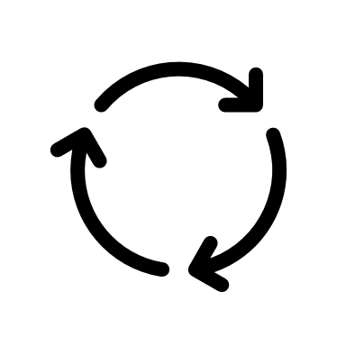
Different Classes and there Methods
Class Ticket
Generate PNR method builds the PNR as per the business rules and returns the generated PNR.
It should be auto-generated by adding first character of source station, first character of destination station, travel date(yyyymmdd) and a running counter starting from 100. Example: BM_20220121_100
Calc Passenger Fare method takes a passenger object as parameter, calculates the fare for the passenger and returns the ticket fare for that passenger. For age < = 12, fare is 50% of ticket price regardless of gender o For age > = 60, fare is 60% of ticket price regardless of gender o For Females, 25% discount on the ticket price
Add Passenger method take passenger details as parameters, creates passenger object and adds the passenger as a key and the calculated passenger fare as the value in Tree Map ‘passengers’
Calculate Total Ticket Price() method returns the total ticket price by adding up all the passenger fares stored in the Tree Map passengers
Generate Ticket method generates the ticket as per the given format and return the ticket in a StringBuilder
Write Ticket method writes the generated ticket to a File
Class Train DAO
Find Train method takes trainNo as input and returns a Train object, if train is found, else returns null

Slide 5
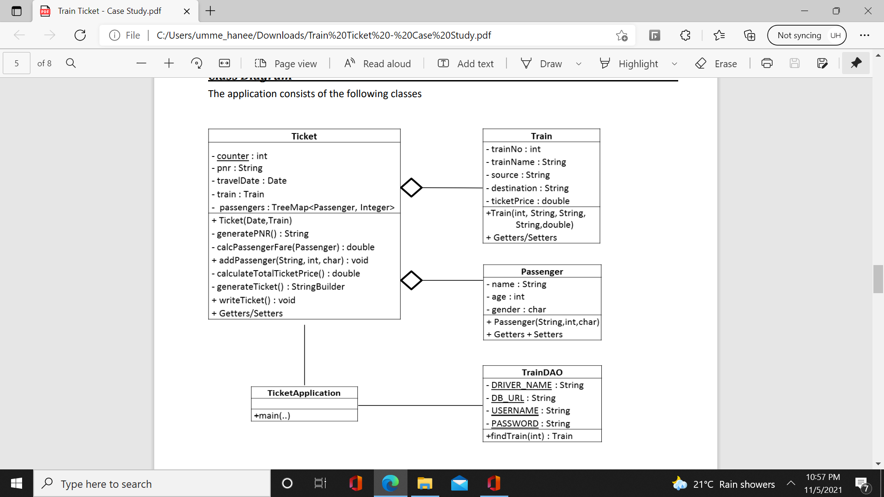
Class Ticket Application
Contains a main method and is the starting point of Application •
Uses a Scanner to get the train No, travel Date, number of Passengers, and details of each passenger •
Uses Train DAO to find the train. If train is not found, it displays the message “Train with given number does not exist” A
Adds passengers to the Ticket •
Writes the ticket to a file
Class Diagram

Slide 6
TECHNOLOGIES USED
FRONTEND(LANGAUGE USED):
HTML
CSS
BOOTSTRAP(FRAMEWORK OF CSS AND JS)
BACKEND:
JAVA
MySQL

Slide 7

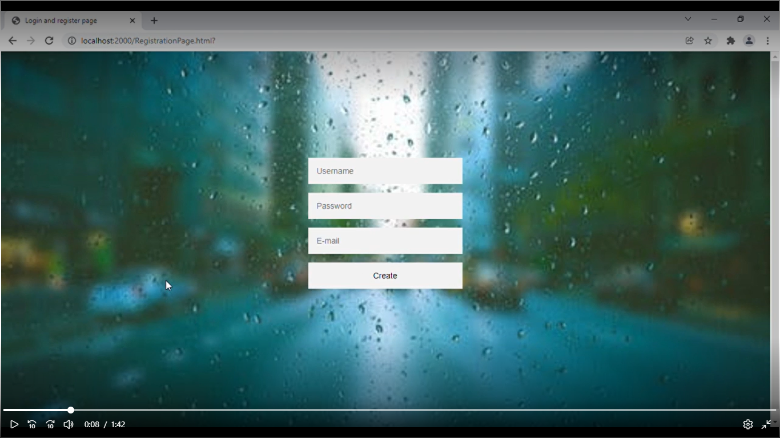
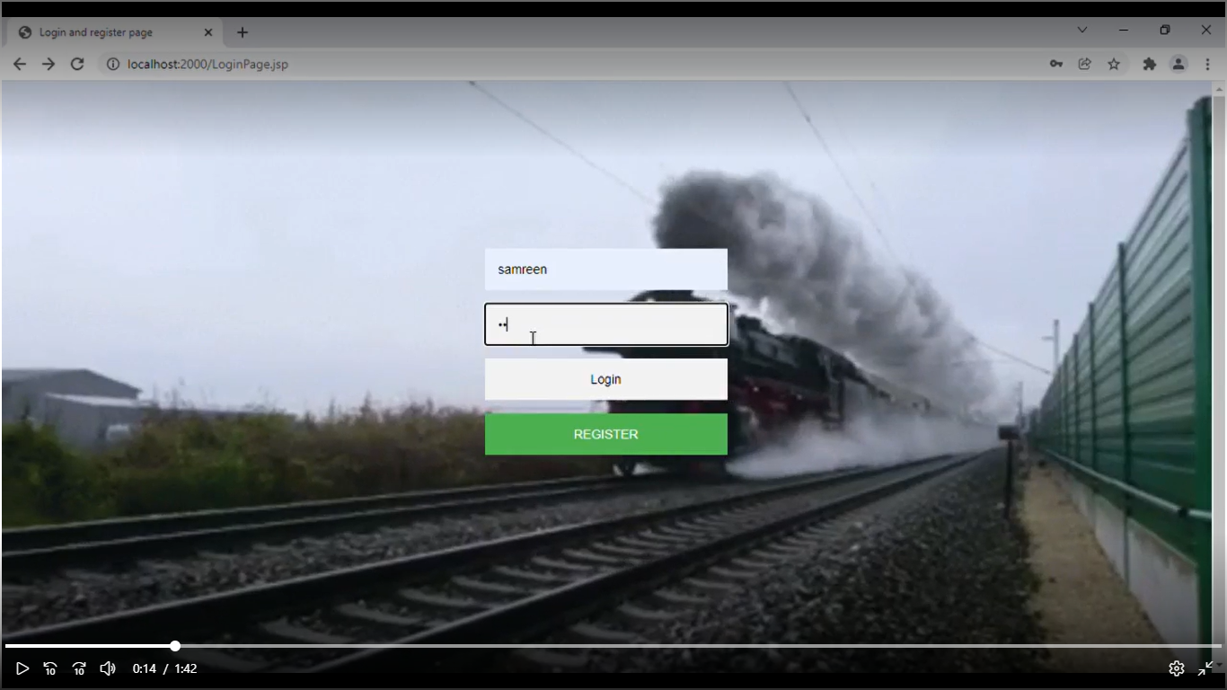
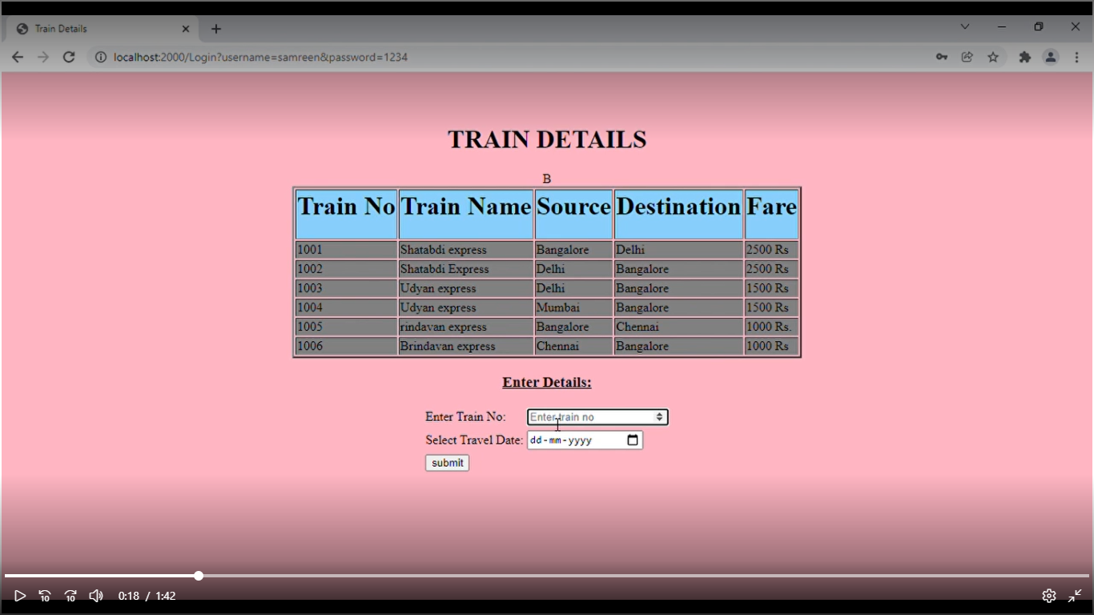


Flow of Application
Registration Page
Login Page
Train Details Page

Slide 8
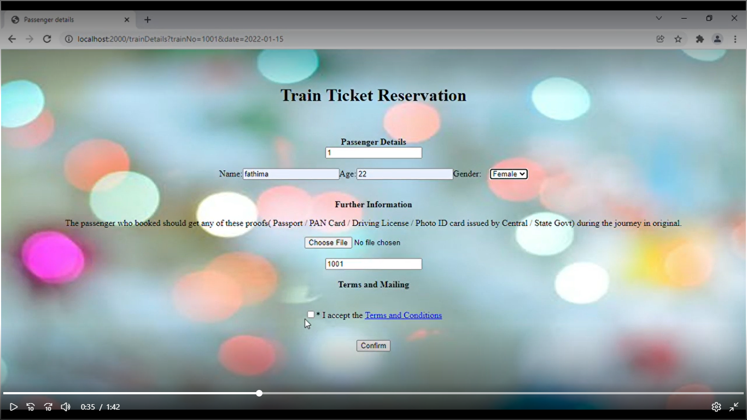
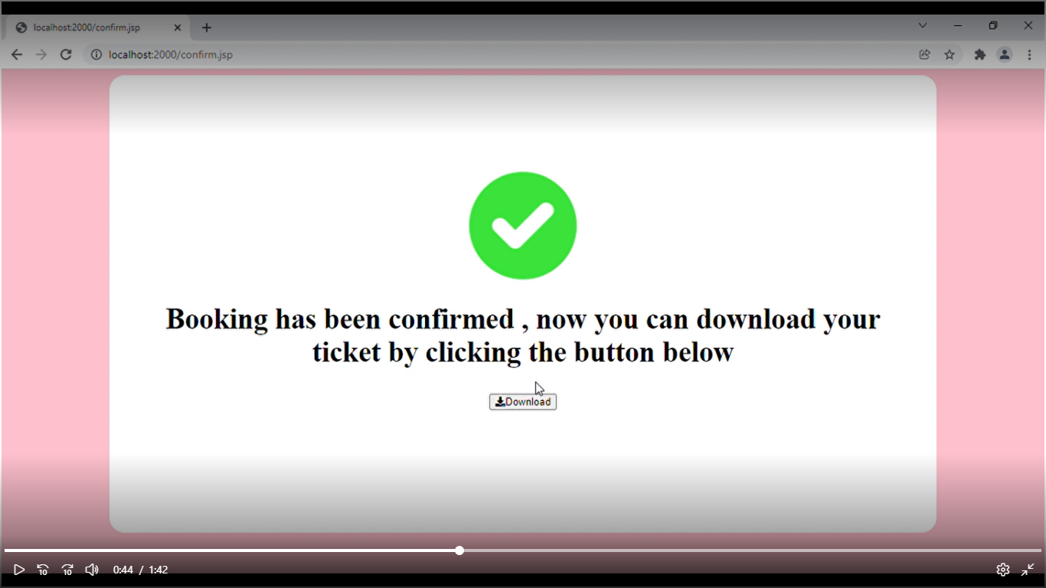
Confirmation Page
Passenger Details Page

Slide 9
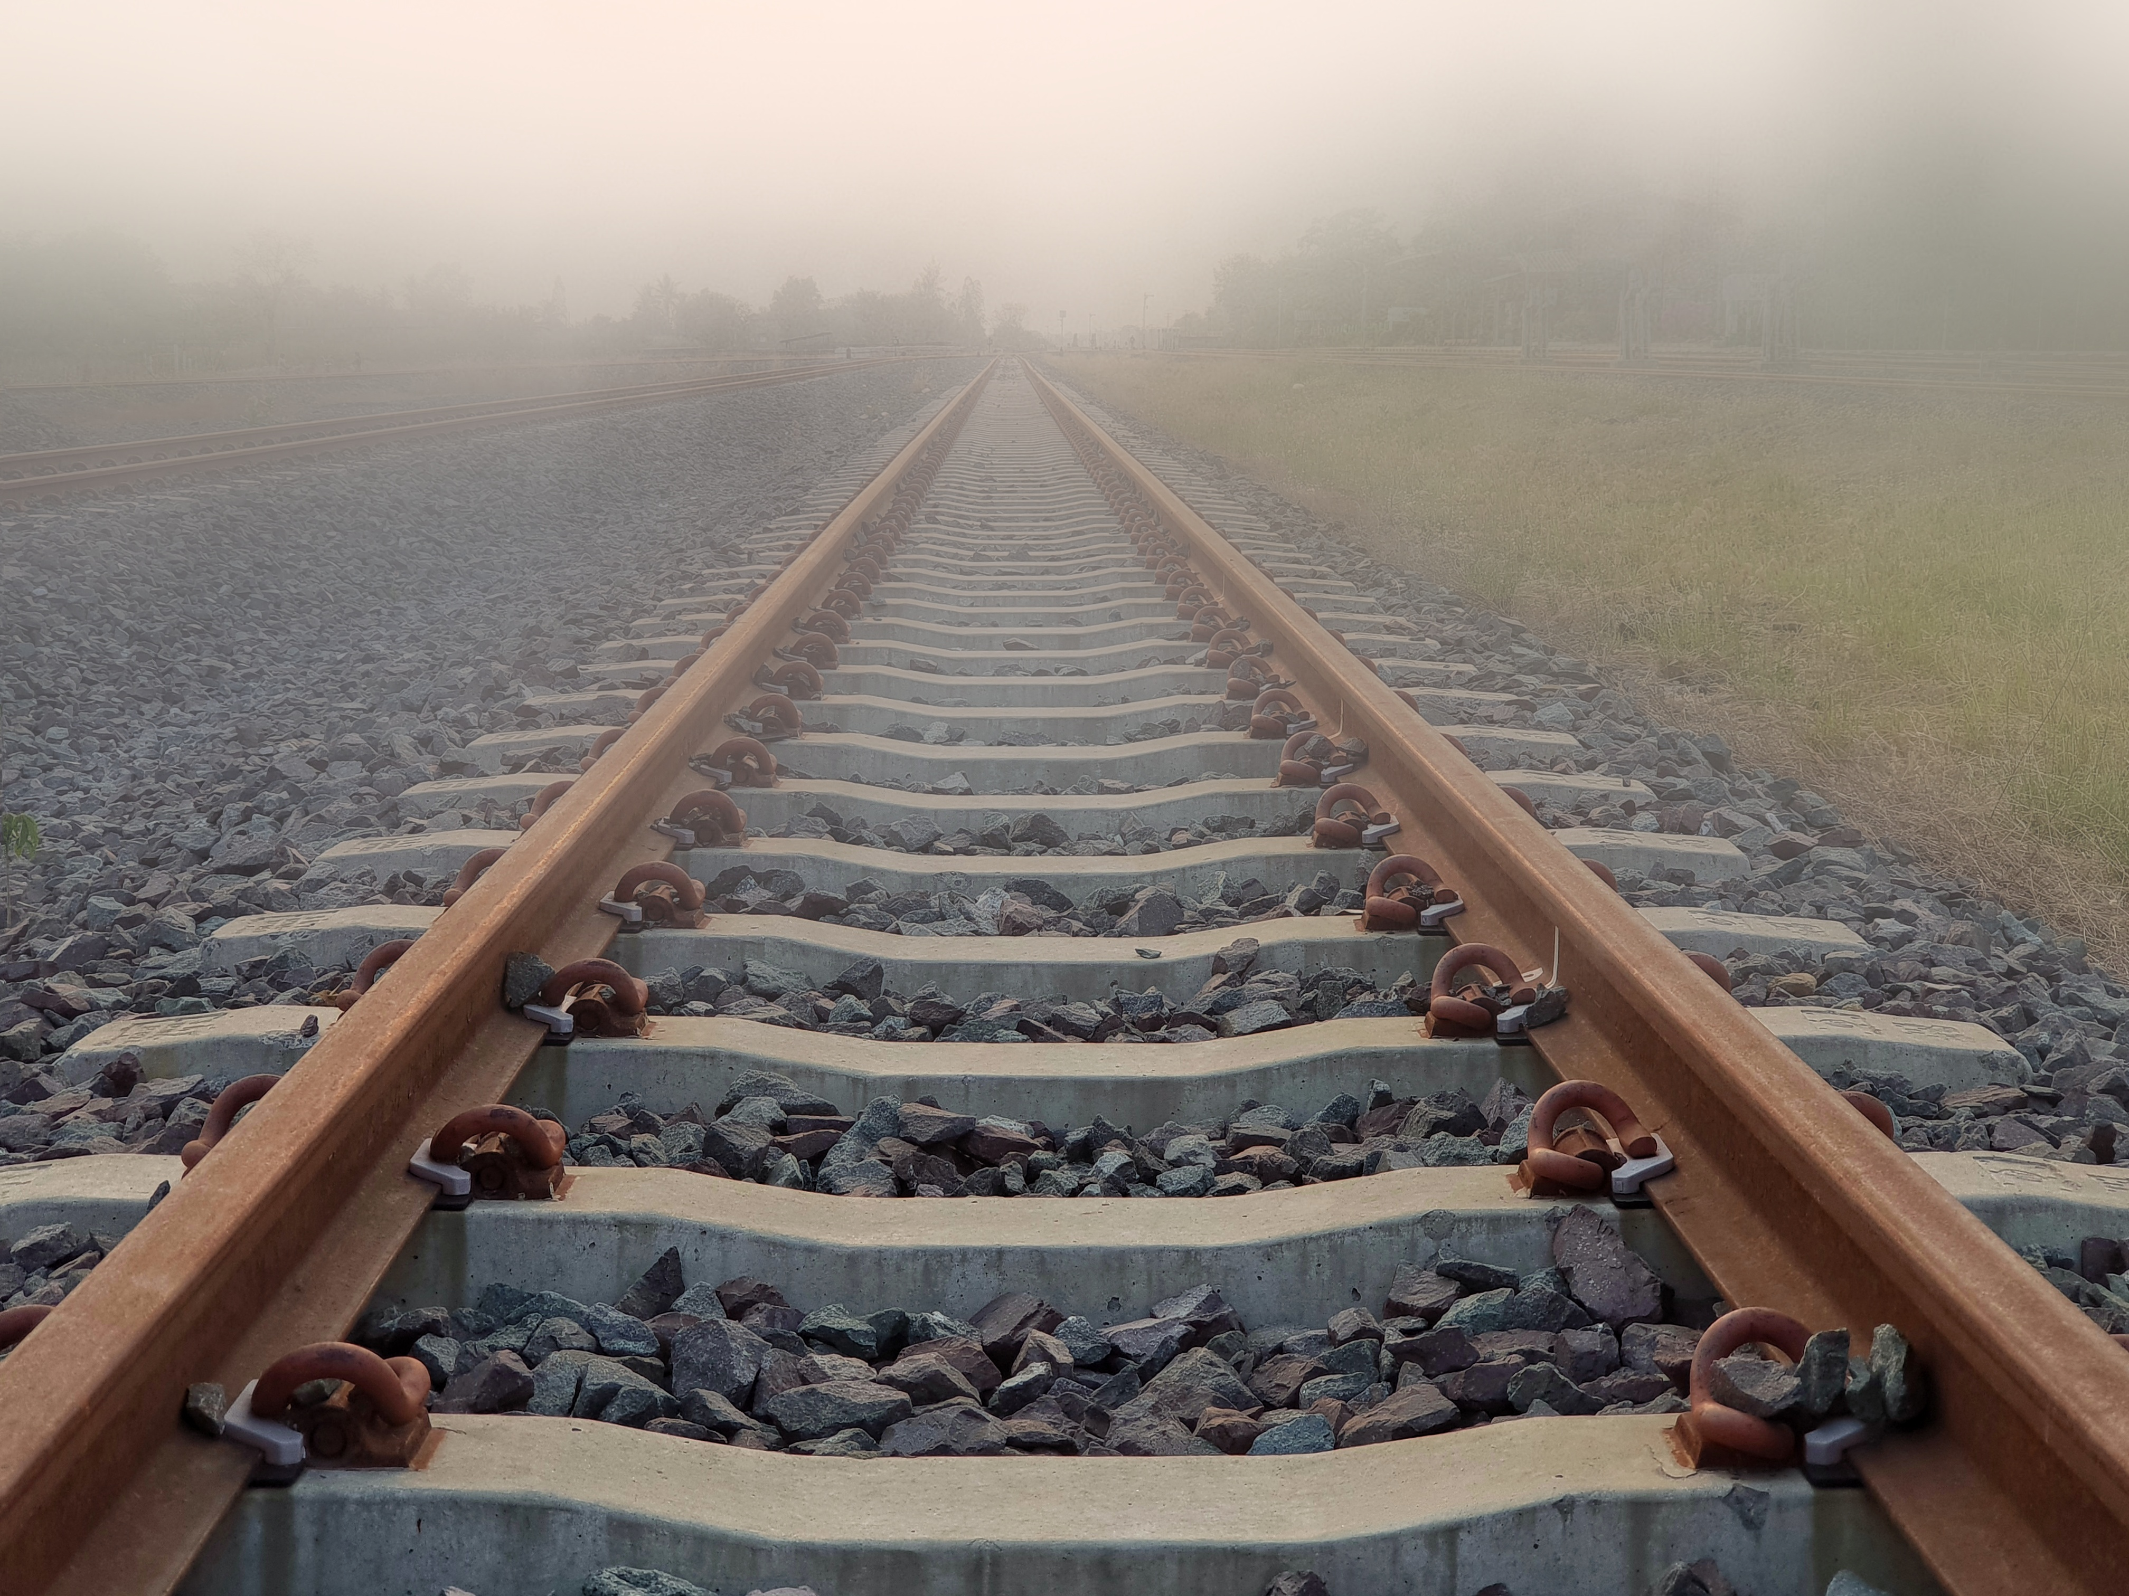
THANK YOU

